Slide 1
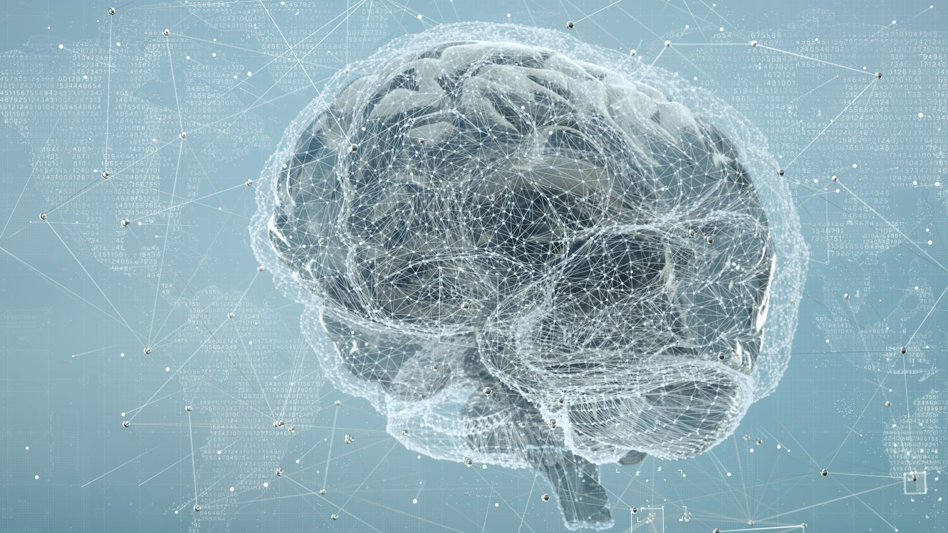
Alzheimer’s AI DUAL AI Model Platform – 2D Slice and 3D Volumetric MRI Analysis
Rakshan Gade | Student ID 02201084 DSC 550, Spring 2026 Advisor: Dr. Donghui Yan | UMass Dartmouth Department of Data Science

Slide 2
Problem Statement
55 Million+ suffer from dementia globally
10 Million new cases are identified every year
70% of dementia sufferers have Alzheimer’s disease
75% of patients go undiagnosed in low-income countries
Key problem : Early diagnosis depends on manual MRI analysis images which are time consuming, expensive and specialist-dependent, Alzheimer AI automates this using deep learning on both 2D MRI slices and full 3D volumetric scans, enabling faster and more accessible screening.

Slide 3
Objectives
Develop a deep learning architecture that is able to detect Alzheimer's disease using MRI images.
Implement dual model support like EfficientNet-B3 for 2D and ResNet3D-18 for 3D scans.
Develop an end-to-end clinical web application with multi-level access to both doctors and patients.
Generate explainable AI results such as Grad-CAM for 2D scans and anatomical slices for 3D scans.
Implement uncertainty flagging to ensure the safety of the results for low confidence cases.
Provide personalized clinical recommendations according to the diagnosis and role of the users.

Slide 4
System Architecture
Four Layers :
Frontend Layer : HTML, CSS, JS, toggle switch for the kind of scanning done like 2D or 3D, uploading the files, displaying the results, doctor’s dashboard, patient’s records.
Backend Layer : JwT authentication, predict endpoint with auto-routing, Grad-CAM generation, patient and scan management endpoints.
AI Model Layer : EfficientNet-B3(2D Model), ResNet3D-18(3D Model), Focal Loss training, Grad-CAM and 3D slice activation maps.
Database Layer : Users and roles table, scans and prediction table, probability scores, model type tracking.

Slide 5
Dataset
OASIS – 1 (2D Model) :
Format : JPG/PNG 2D MRI slices.
Classes : Non Dementia, Very Mild Dementia, Mild Dementia.
Split : 70% train / 15% val / 15% test
Source : Kaggle OASIS dataset
Neurite OASIS (3D Model) :
414 subjects with full brain MRI volumes
Format : .nii.gz (160x192x224 voxels, preprocessed)
Labels derived from Clinical Dementia Rating scores
Class distribution: Non Demented, Very Mild Demented, Mild Demented
Split : 70% train / 15% val / 15% test
Zero subject overlap verified across all splits

Slide 6
2D Model – EfficientNet-B3
Architecture :
EfficientNet-B3 is the backbone with pretrained ImageNet weights.
Custom classifier head : Dropout(0.4) → Linear(256) → ReLU → Dropout(0.3) → Linear(3).
Input : 224 x 224 RGB MRI slice.
Output : 3 classes – Non Demented, Very Mild Demented, Mild Demented.
Training Details :
Dataset : OASIS-1 (Kaggle 2D MRI slices)
Loss : CrossEntropy with Label Smoothing
Optimizer: AdamW, LR = 1e-4
Explainability : Grad-CAM heatmap overlay on predicted class
Final Accuracy: 97.7%

Slide 7
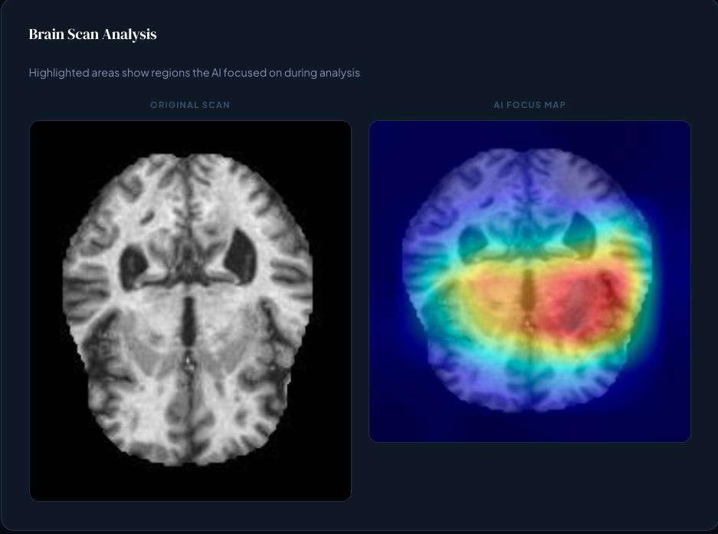
2D Model Results
Key metrics:
Test Accuracy: 97.7%
Model : EfficientNet-B3
Classes : 3
Grad-CAM : Visual explanation generated for every prediction

Slide 8
3D Model – ResNet3D-18
Architecture :
Custom ResNet3D-18 built from scratch with no pretrained weights
Stem : Conv3D 7x7(Stride 2) + Conv3D 3x3(stride 2)
4 residual layers [2,2,2,2] with ResBlock3D
Strided Conv3D replaces MaxPool3D to fix the MPS compatibility
AdaptiveAvgPool3D → Dropout(0.5) → Fully Connected (3 classes)
Input: 96x96x96 single-channel NIFTI volume
Trainable parameters : 18.7 million
Training Details :
Dataset : Neurite-OASIS (414 subjects, .nii.gz format)
Labels : CDR score mapped to 3 classes (0.0 → Non Dementia, 0.5 → Very Mild Dementia, 1.0+ → Mild Dementia)
Loss : Focal Loss (γ=2.0) to address class imbalance
Optimizer : AdamW, LR = 3e-5
Sampler: WeightedRandomSampler

Slide 9
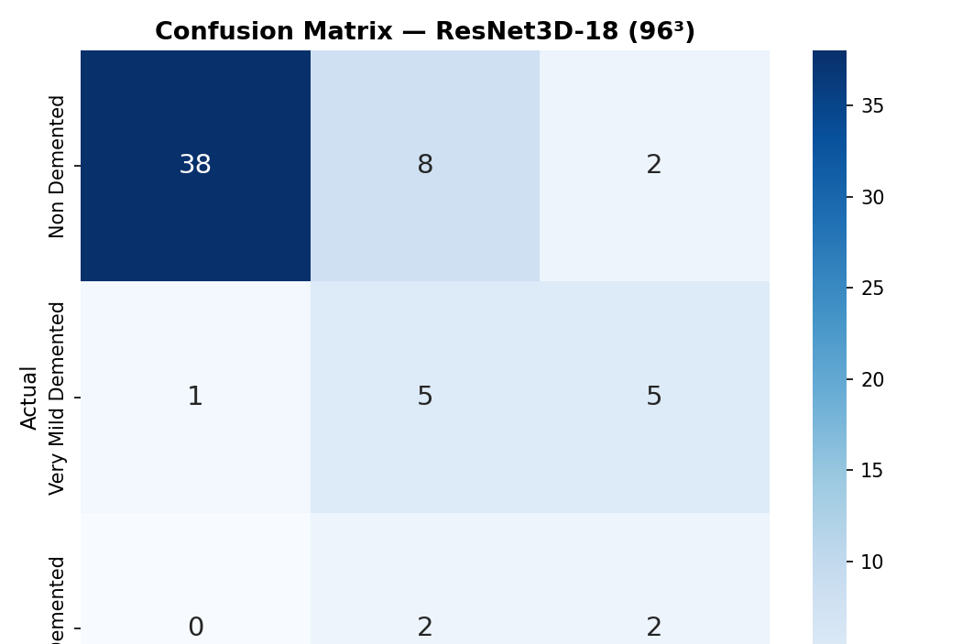
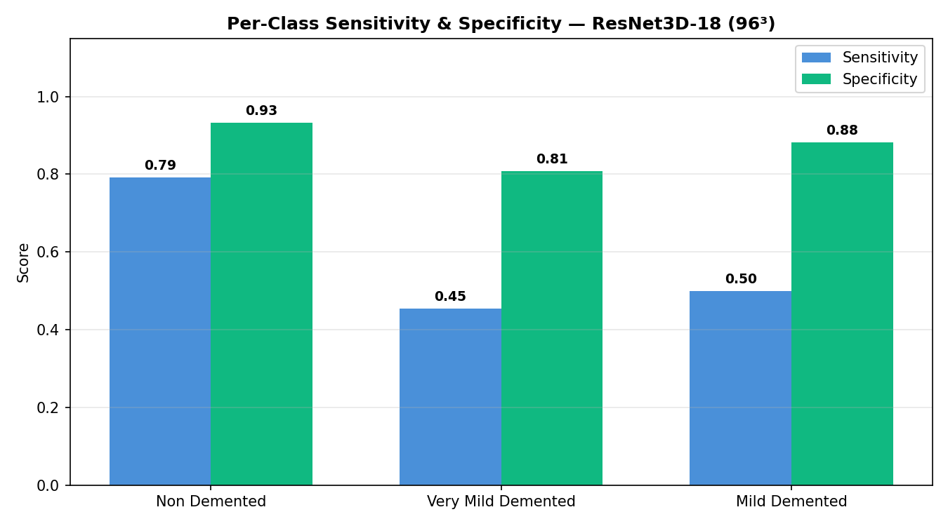
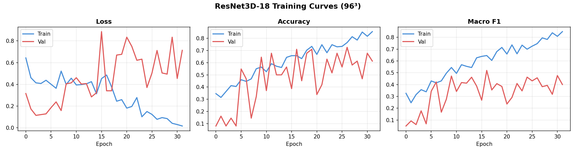
3D Model Results
Key metric :
Test accuracy : 71.43%
Model - ResNet3D-18
Confidence Interval lies between 60.3 % - 82.6%
Macro F1 score across all 3 classes averaged at 0.522
F1 score weighted by class support would be at 0.752
Cohen’s kappa measures at 0.402 between predictions and true labels
ROC-AUC Area under the ROC curve averaged across all 3 classes at 0.742
Mean Prediction Confidence Average softmax probability of the predicted class across all test scans at 69.8%
Uncertain predictions flagged percentage of test predictions where model confidence fell at 57.1%

Slide 10
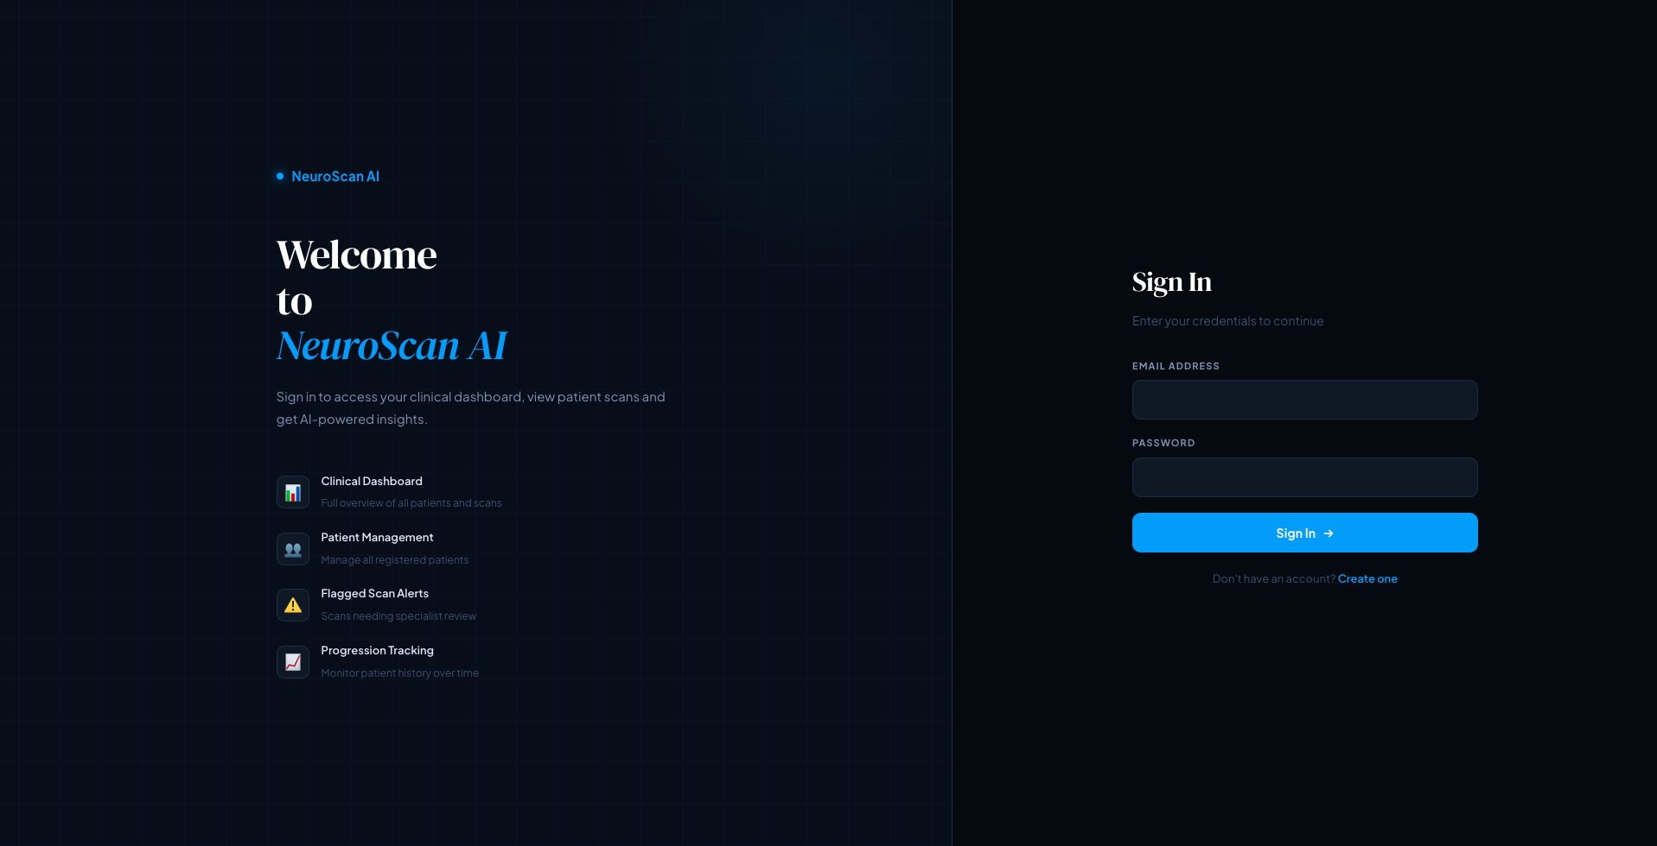
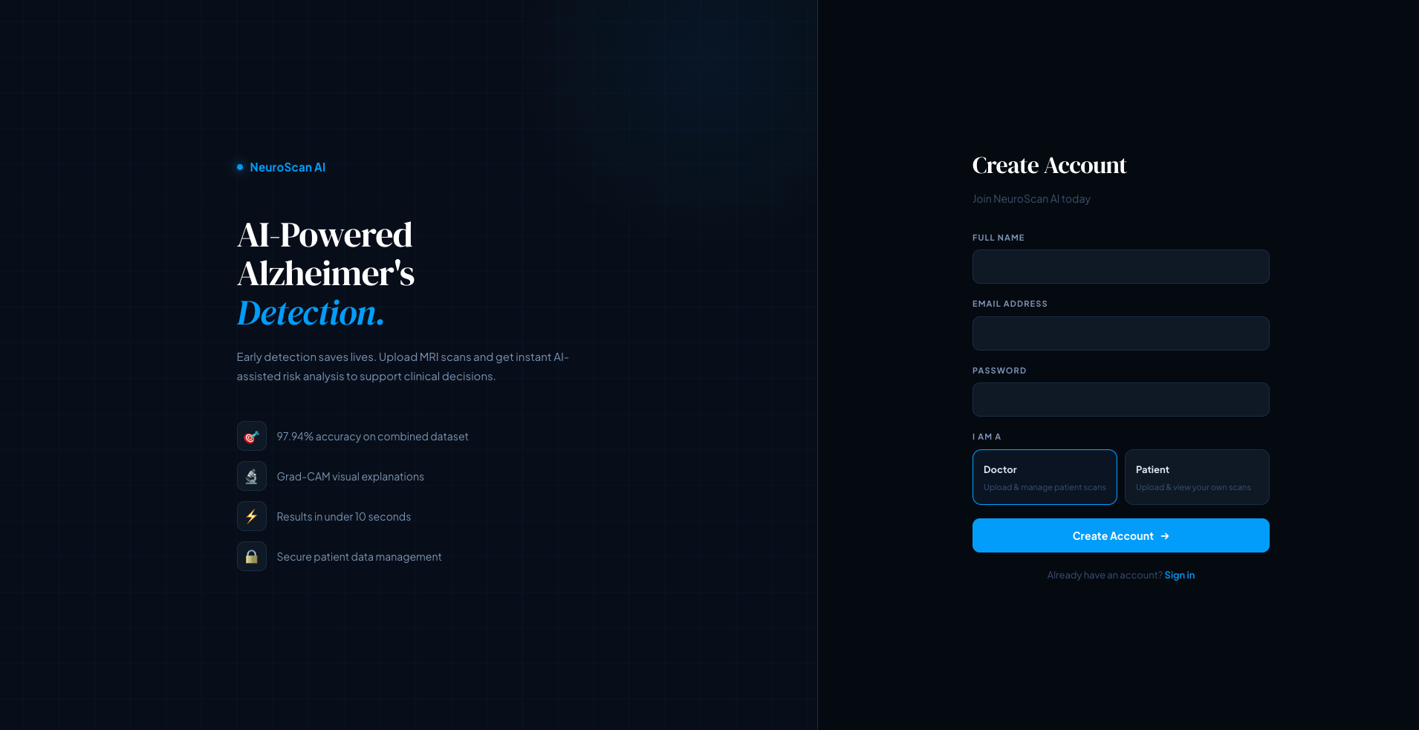
Login & Register
JwT- based authentication with role separation
Two user roles : Doctor and Patient
Doctors can register and access all patient scans and the dashboard
Patients can register and only see their own scan history
Passwords stored securely with hashing
Token stored in local storage and sent with every API request

Slide 11
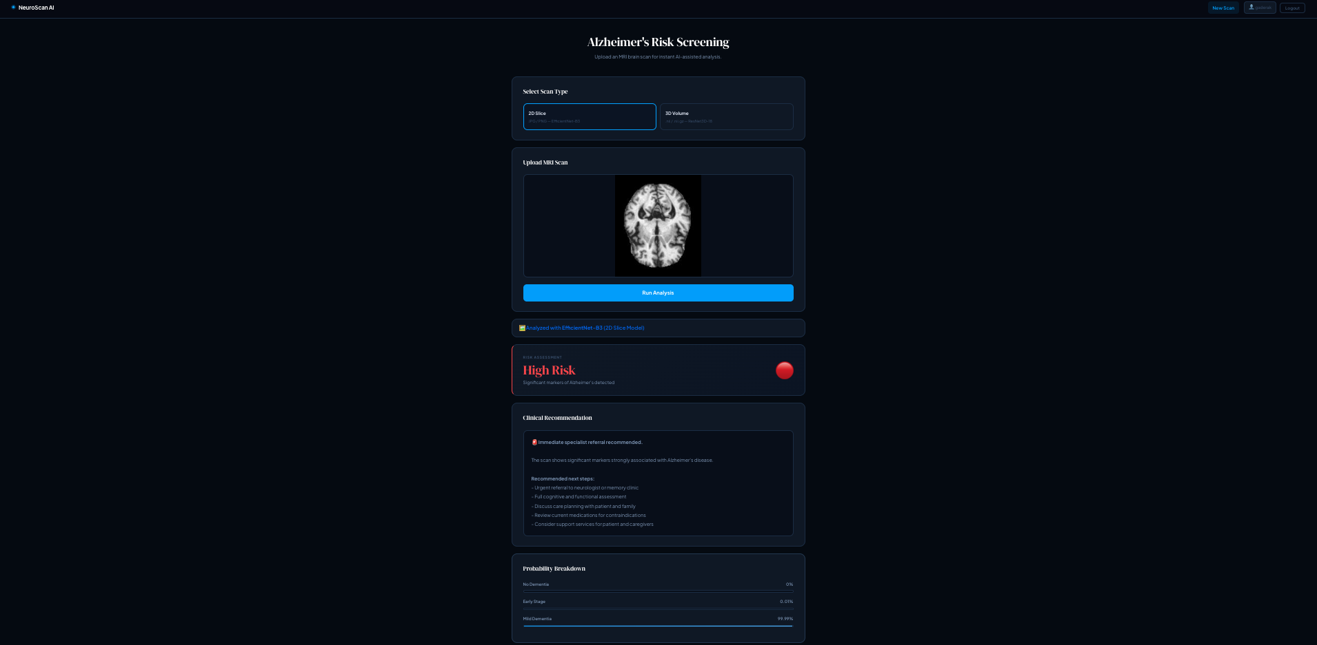
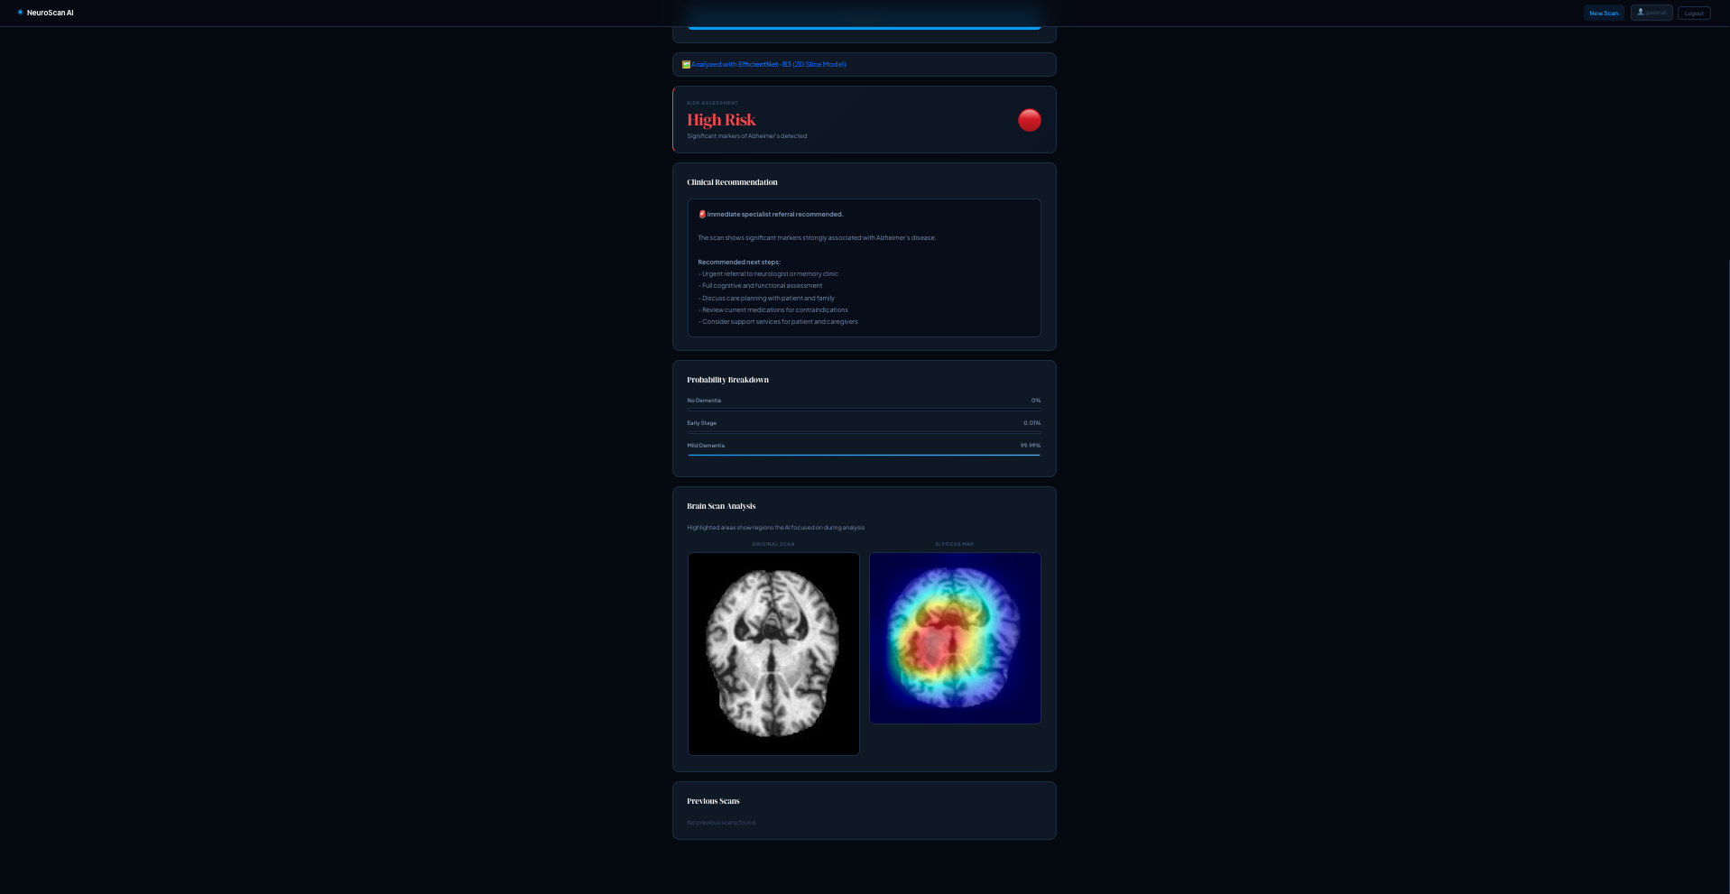
2D Scan Analysis
Users select 2D slice mode and uploads a JPG or PNG MRI scan
EfficientNet-B3 runs inference and runs prediction in seconds
Results : Risk level badge, confidence score, probability breakdown bars
Grad CAM heatmap displayed side by side with original scan
Clinical recommendation shown respectively for doctors and patients
Uncertainty warning displayed if confidence is below 70%

Slide 12
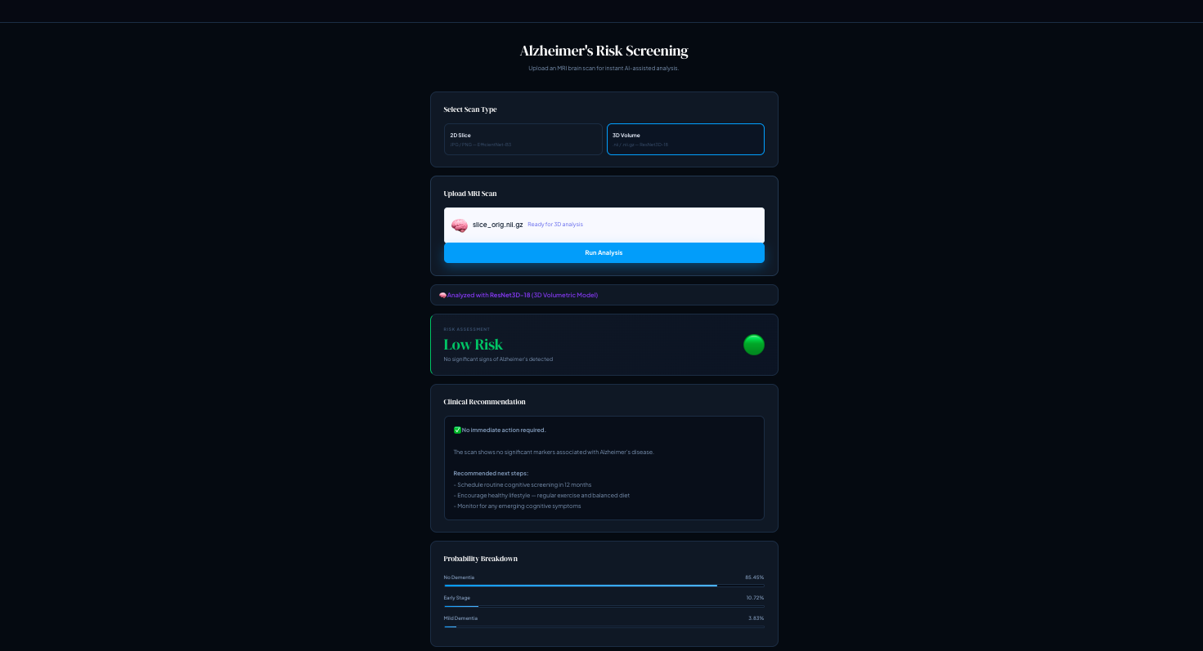
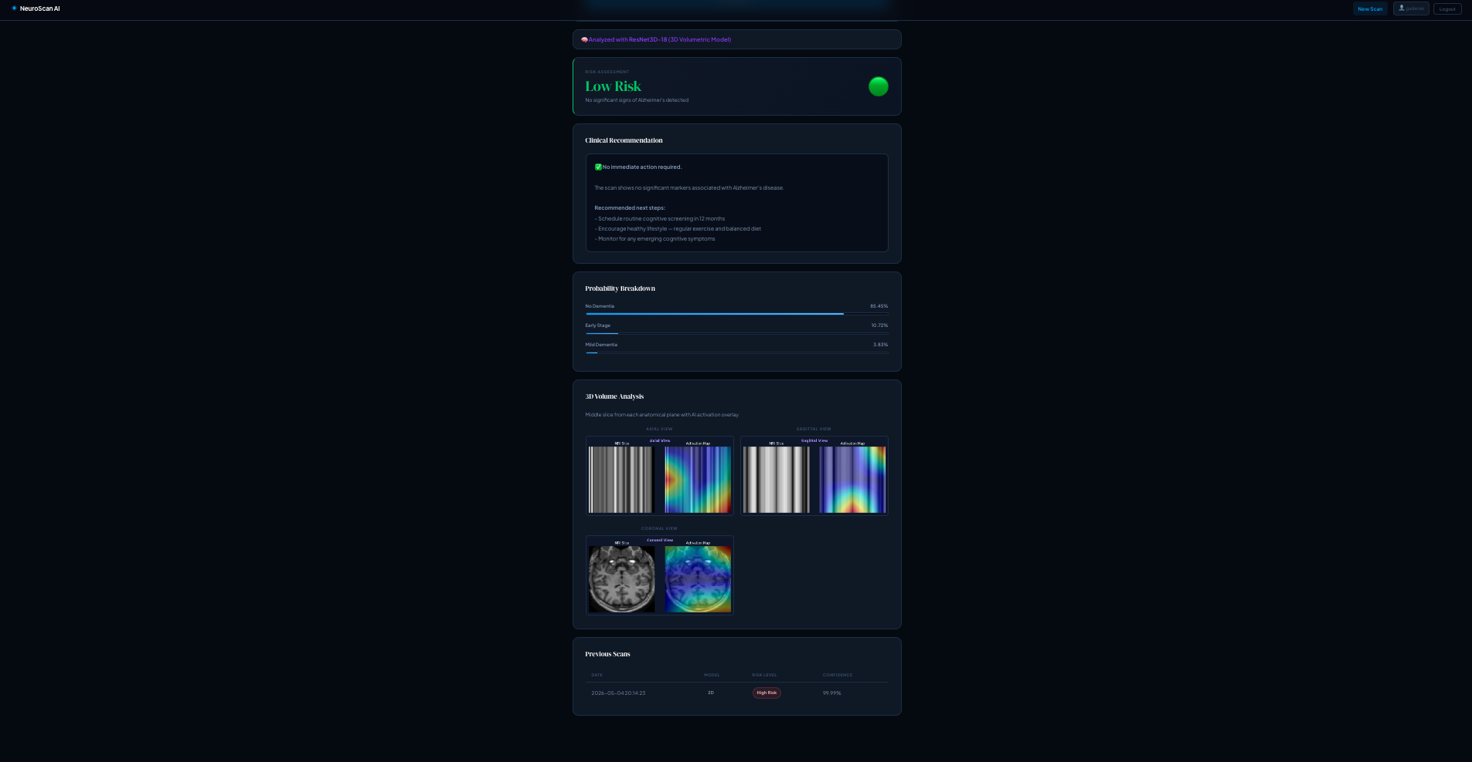
3D Volume Analysis
User selects 3D volume mode and uploads a .nii.gz volumetric MRI file
ResNet3D-18 processes full 3D volume resized to 96 x 96x 96 voxels
Three anatomical view are Axial, Sagittal and Coronal each with Grad-CAM overlay
Same risk level, confidence and recommendation system as the 2D model
Model badge clearly identifies ResNet3D-18 as the model used for analysis
Grad-CAM section hidden for 3D which is replaced with anatomical slice viewer

Slide 13
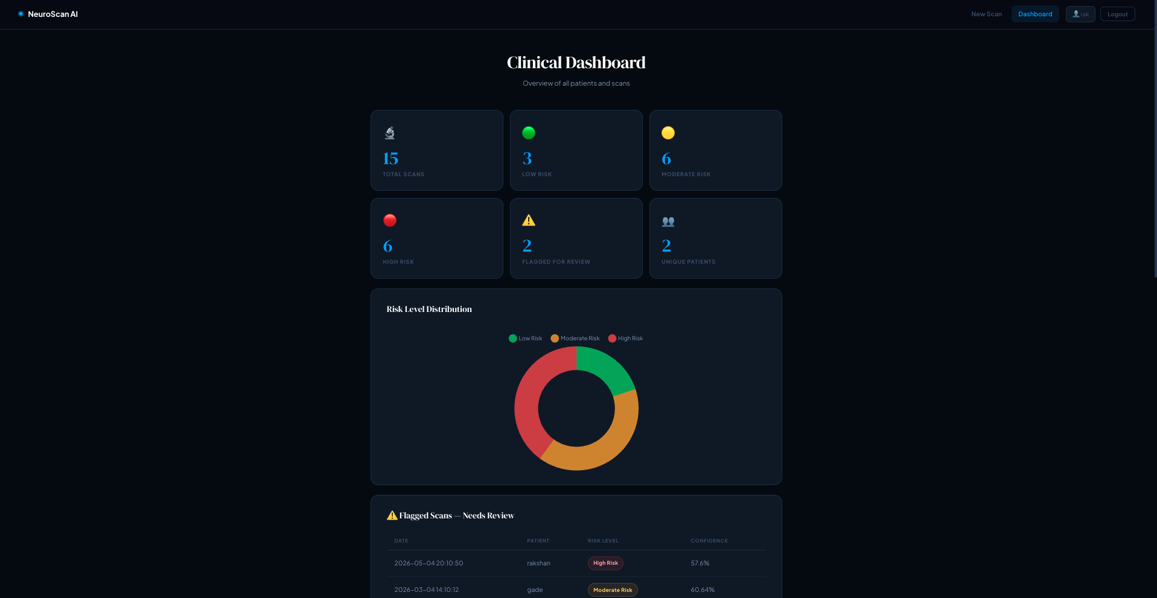
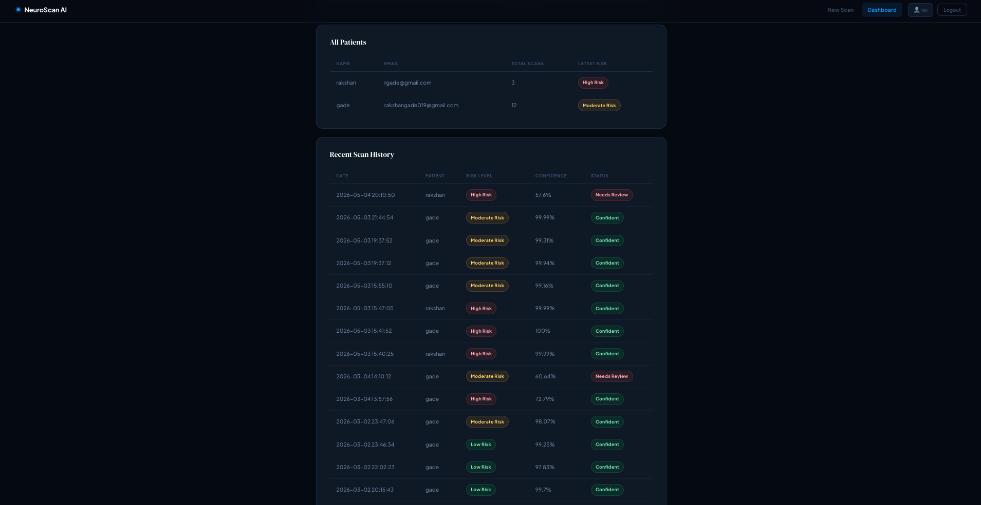
Doctor Dashboard
Doctors see aggregate statistics like total scans, risk level breakdown and unique patients
Model usage breakdown shows how many 2D vs 3D scans have been run
Flagged scans section highlights all low-confidence predictions requiring review
Full patient management like doctors can select patients before running a scan
Previous scans history table shown date, model type, risk level and confidence
Role based access strictly enforced where patients cannot access dashboard

Slide 14
Challenges
Apple M3 MPS – 3D pooling ops not supported, so replaced MaxPool3d with strided Conv3D and trained on CPU overnight
Class imbalances with 314 Non Dementia and 30 Mild subjects where focal loss γ=2.0 with WeightedRandomSampler to oversample minority classes
Google Collab drive mount credential failure, so bypassed cloud entirely and trained on local system
Browser blocking .nii.gz file selection, so changed to accept wildcard to detect file type by filename extension in JS
Nibabel cannot read .nii.gz from memory bytes, so wrote bytes to temp file, load it via nibabel then delete it cleanly

Slide 15
Conclusion & Future Work
Conclusion :
EfficientNet-B3: 97.7% accuracy with Grad-CAM explanations
ResNet3D-18 : ROC-AUC 0.74, Kappa 0.40 on 414 subjects
Dual 2D and 3D platform with full clinical workflow built from scratch
Future Work :
Medical Net pretrained 3D weights to transfer learning
ADNI dataset (2000+ subjects) for stronger 3D model
Auto-generate clinical PDF report with scan images

